Slide 1
MCTE 3104 Mechatronics Interfacing Lab
Experiment no. 1: Intro to GPIO of ATMega & Raspberry Pi

Slide 2
Outline
ATMega pinouts
Raspberry Pi pinouts

Slide 3
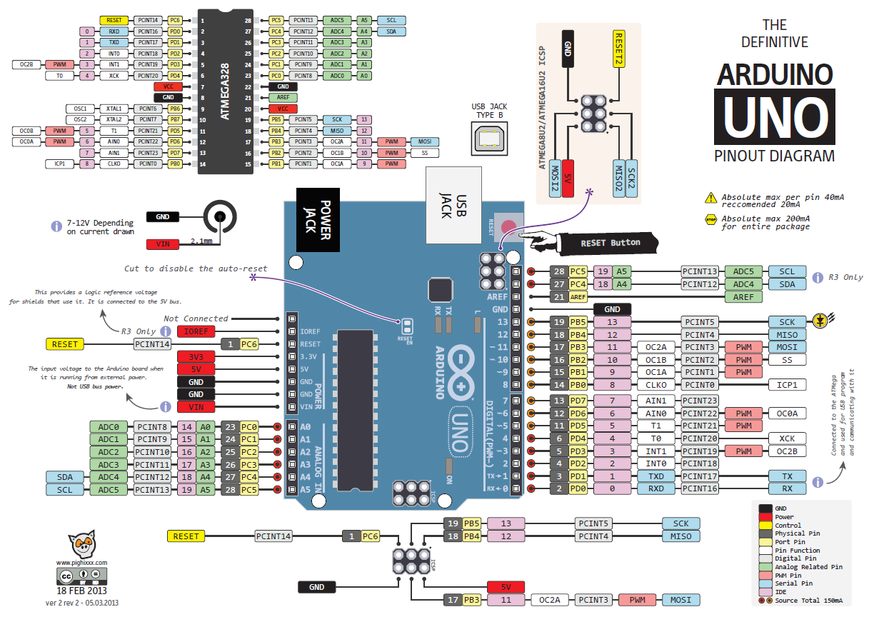

Slide 4
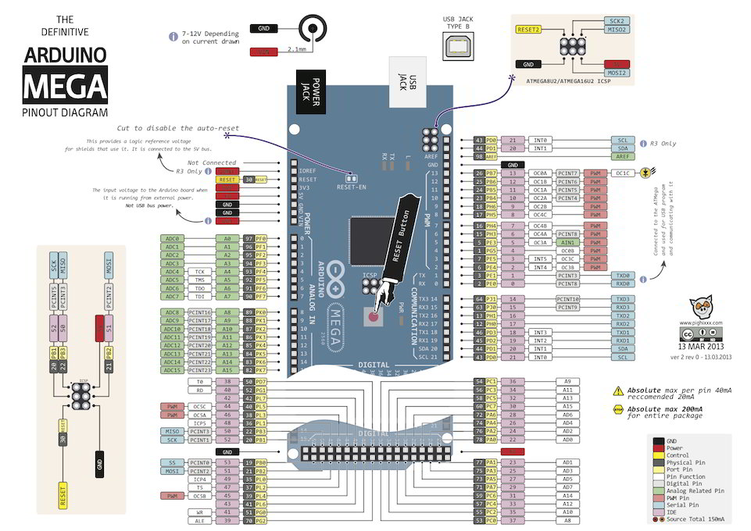

Slide 5
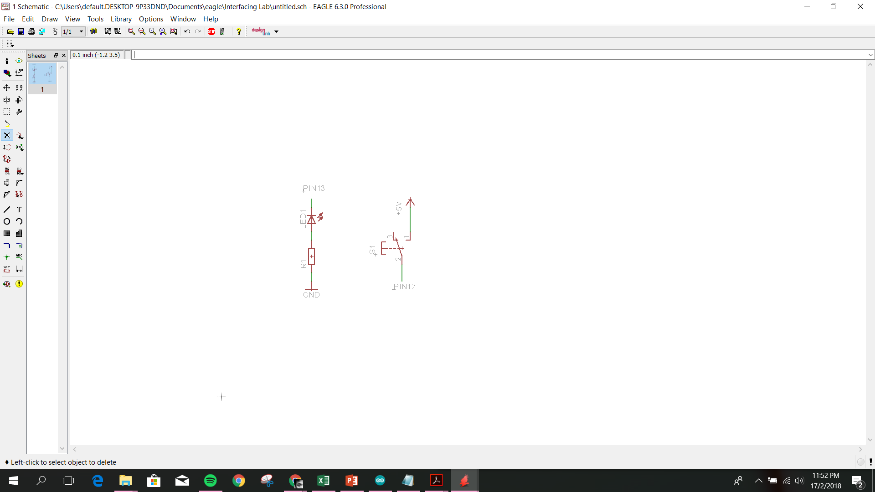
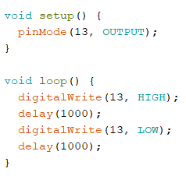
Simple GPIO control using Arduino Library
Writing digital output
By default Arduino board has a built-in LED on board connected to pin 13.

Slide 6
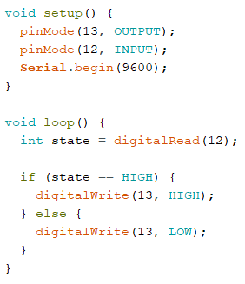
Simple GPIO control using Arduino Library
Reading digital input

Slide 7
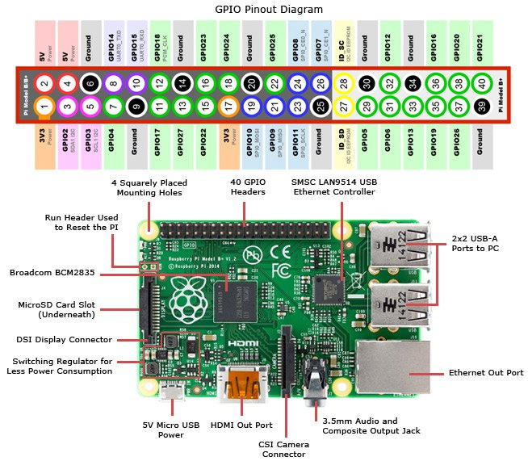

Slide 8
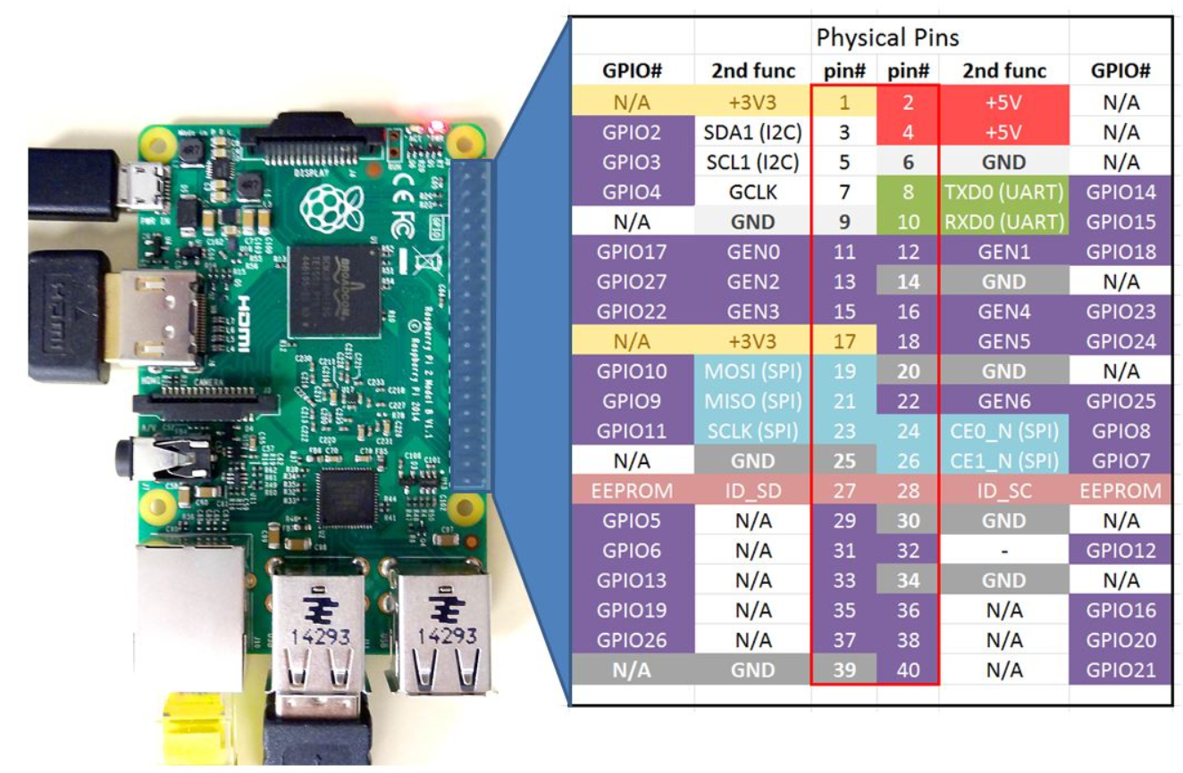
To begin using the Raspberry Pi GPIO, we first need to know Raspi's GPIO numbering system. The two inner columns (labelled pin#) in the chart shows the ‘physical pin number’ where as the outer two columns (labelled GPIO#) of the chart shows you the ‘BCM number’ (Broadcom numbering scheme).
Picture taken from
http://www.toptechboy.com/raspberry-pi/raspberry-pi-with-lesson-26-controlling-gpio-pins-in-python/

Slide 9
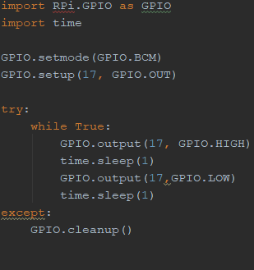
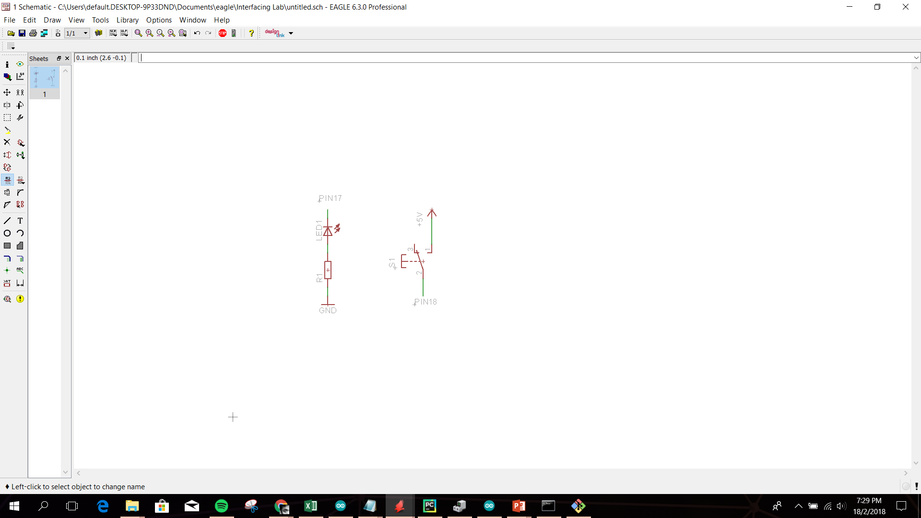

Slide 10
